Slide 1
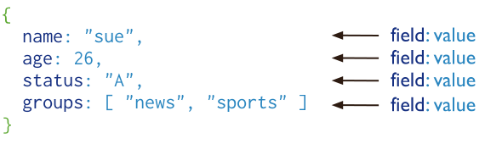
MongoDB
MongoDB is a open-source document database that provides high performance, high availability and automatic scaling.
Document Database
A record in MongoDB is a document, which is a data structure composed of field and value pairs. MongoDB documents are similar to JSON objects. The values of fields may include other documents, arrays, and arrays of documents.

Slide 2
MongoDB
The advantages of using documents are:
Documents correspond to native data types in many programming languages.
Embedded documents and arrays reduce need for expensive joins.
Dynamic schema supports fluent polymorphism.
Features:
High Performance
Query API
High Availability
Horizontal Scalability
Support for Multiple Storage Engines

Slide 3
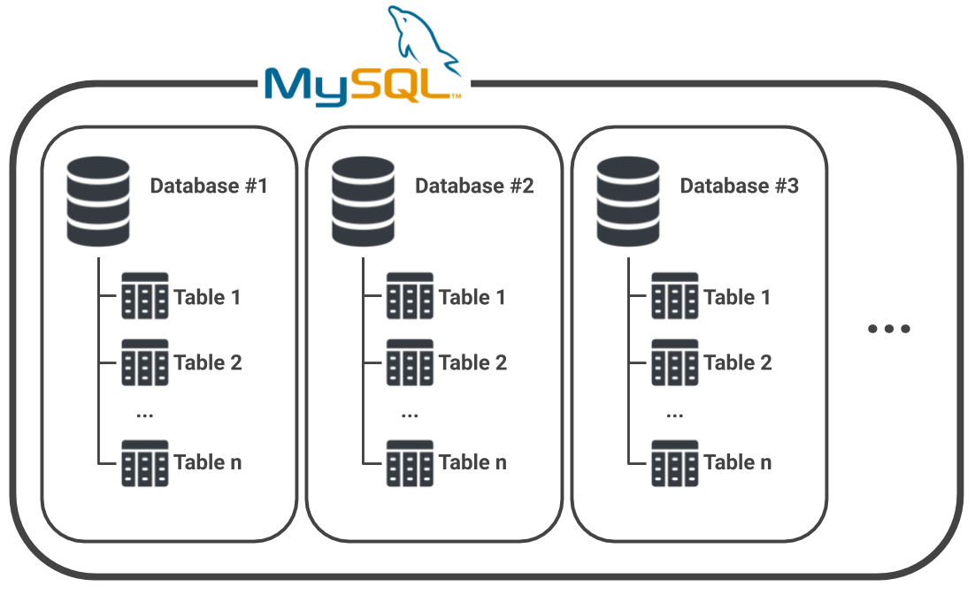
MySQL
MySQL is an open-source, fast reliable, and flexible relational database management system, typically used with PHP. This chapter is an introductory chapter about MySQL, what is MySQL, and the main features of MySQL are described here.

Slide 4
MySQL
Features:
MySQL server design is multi-layered with independent modules.
MySQL is fully multithreaded by using kernel threads. It can handle multiple CPUs if they are available.
MySQL provides transactional and non-transactional storage engines.
MySQL has a high-speed thread-based memory allocation system.
MySQL supports in-memory heap table.
MySQL Handles large databases.
MySQL Server works in client/server or embedded systems.
MySQL Works on many different platforms.

Slide 5
Comparison between SQL and NoSQL
SQL | NoSQL
Databases are categorized as Relational Database Management System (RDBMS). | NoSQL databases are categorized as Non-relational or distributed database system.
SQL databases have fixed or static or predefined schema. | NoSQL databases have dynamic schema.
SQL databases display data in form of tables so it is known as table-based database. | NoSQL databases display data as collection of key-value pair, documents, graph databases or wide-column stores.
SQL databases are vertically scalable. | NoSQL databases are horizontally scalable.
SQL databases use a powerful language "Structured Query Language" to define and manipulate the data. | In NoSQL databases, collection of documents are used to query the data. It is also called unstructured query language. It varies from database to database.
SQL databases are best suited for complex queries. | NoSQL databases are not so good for complex queries because these are not as powerful as SQL queries.
SQL databases are not best suited for hierarchical data storage. | NoSQL databases are best suited for hierarchical data storage.

Slide 6
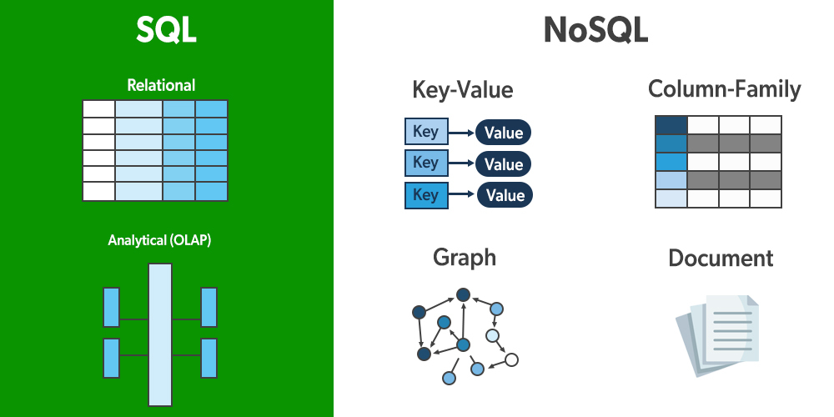
Examples of SQL and NoSQL
SQL | NoSQL
MySQL, Oracle, SQLite, PostgreSQL and MS-SQL | MongoDB, Bigtable, Redis, Raven DB, Cassandra, HBase, Neo4j, CouchDB

